Slide 1
Infrastructure Automation with Terraform & Azure Devops on Azure cloud
Harshal Mittal

Slide 2
Modules using local paths Section 6
Notes:
Lets learn about modules and using them with local relative paths.

Slide 3
Modules using local paths
Create a new directory and place one or more related .tf files in it to create a root module.
Notes:
Modules using local paths.
These are the modules which you create locally as per your requirements.
To define a module, create a new directory for it and place one or more related .tf files inside just as you would do
for a root module.

Slide 4
Modules using local paths
Create a new directory and place one or more .tf files in it to create a root module.
Terraform can load modules from local relative paths to be used by a child module.
Notes:
Terraform can load modules from local relative paths when they are called by child modules.

Slide 5
Modules using local paths
Create a new directory and place one or more .tf files in it to create a root module.
Terraform can load modules from local relative paths to be used by a child module.
Root module
├── main.tf
├── variables.tf
├── outputs.tf
Notes:
Now let us create a root module
By creating a directory which includes all the related files like the input variables.tf, all required resources in main.tf file
And to export relevant useful attributes information in an output.tf file. Now our root module is created.

Slide 6
Modules using local paths
Create a new directory and place one or more .tf files in it to create a root module.
Terraform can load modules from local relative paths to be used by a child module.
Child module calls root module
module {
source = “root module path”
}
Root module
├── main.tf
├── variables.tf
├── outputs.tf
Notes:
Now we call the root module through child module by creating a module block in the configuration files of child module and mentioning the only mandatory source field with the argument as local relative path of root module directory. This is the way how modules work and in this way we can reuse the root module code at multiple places.

Slide 7
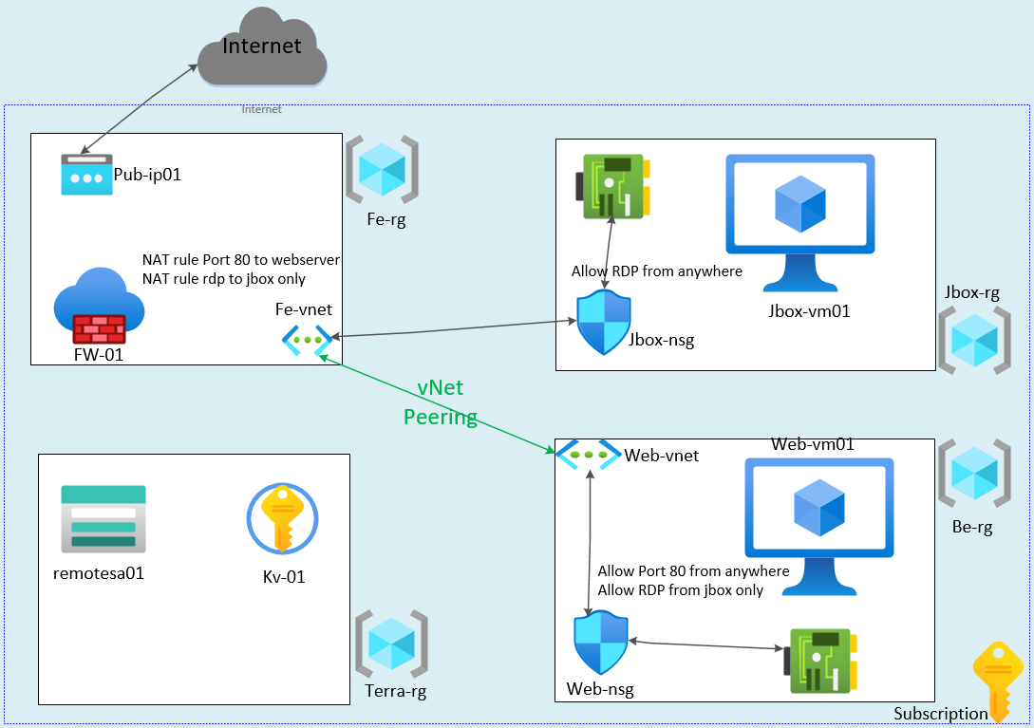
Redesign our lab using modules
Notes:
Now let us redesign our lab using modules concept. Let us rethink by watching this layout, where we can reduce the code duplication and implement modules.

Slide 8
Redesign our lab using modules
Notes:
Redesigned layout of our real life infrastructure scenario
I have enclosed the repeatedly deployed resources that we deployed twice in our lab by yellow round shape rectangle in jumpbox resource group and a corner snipped yellow rectangle in backend resource group. Now let us create a root module for those resources and then reimplement the lab by calling root module through child module.

Slide 9
Root Module design
Resources to deploy by root module are network interface, NSG and a Virtual machine.
Notes:
Steps of root module design
Now based on our scenario, let us design a root module, we need Network interface, NSG and virtual machine to be deployed by root module.

Slide 10
Root Module design
Resources to deploy by root module are network interface, NSG and a Virtual machine.
Input variables required are rg, location, nic-name, nsg-name, vm-name, subnet-id and admin-password.
Notes:
To deploy all these resources we need to know the resource group name, location, network interface name, nsg-name, vm-name, subnet-id and admin-password. We can generalise it more as by creating more input variables like vm image reference, vm size, admin-username, managed disk type and other variables. You can do it an exercise in you lab by using them addition input variables. For now let us continue designing the root module.

Slide 11
Root Module design
Resources to deploy by root module are network interface, NSG and a Virtual machine.
Input variables required are rg, location, nic-name, nsg-name, vm-name, subnet-id and admin-password.
Output variables required are nic-private-ip, vm-id and nsg-name.
Notes:
As an output variable point of view, I think we will need network interface private ip address for dnat and nsg rules
Another required output will be vm-id will be required to deploy webserver extension on the vm and the nsg-name. So in this case we can export the attributes of resources as per our requirements. If this module will be re-used by lots of configurations you may wish to place it in its own version control repository as it will be kept changing over the time. You will always be adding more input and output variables as per your changing requirements over time.

Slide 12
Demo
Notes:
Let us create the root module and using that module to redeploy our lab.

Slide 13
Modules using terraform registry
Next video
Notes:
In the next video we are going to setup another lab on Modules using terraform registry.

